Slide 1

3D PERCEPTION & LEARNING BASED DATA FUSION
Object Detection with LiDAR Point Clouds & Estimation of 3D Bounding Boxes
PRESENTER
Sri Hari Padmanaban

Slide 2
Table of Contents
Introduction
Tools & Input Dataset
Processing Workflow & Code Walkthrough
LiDAR-to-Camera Coordinate Transformation
Construction of 3D Bounding Box
Multi-Object Visualization
Learnings & Challenges
Conclusion & References

Slide 3
Introduction
The objective is to connect raw LiDAR returns and detect the object in the environment and to estimate the 3D bounding boxes for the object. This project builds a Python pipeline for inspecting KITTI LiDAR point clouds and visualizing labeled objects as oriented 3D boxes.

Slide 4
Tools & Input Dataset Used
Tools:
VS Code
Python
Open3D
NumPy
Matplotlib
WSL
Dataset:
The KITTI dataset provides real-world driving data collected using cameras and LiDAR sensors.For this project, I used its LiDAR point clouds, object labels, and calibration files to visualize objects and their 3D bounding boxes.

Slide 5
Processing Workflow & Code Walkthrough
Choosing of KITTI frame and importing its LiDAR scan, labels and calibration file.
Reading of LiDAR scan as points containing x, y, z coordinates and its reflectance value.
Transforming of LiDAR coordinates into rectified camera coordinates.
Reading of object labels including class, dimensions, location and orientation
Building of bounding box for each supported labelled object
Displaying of point clouds and boxes in 3D viewer using different colors different classes.

Slide 6
LiDAR to Camera Coordinate transformation
LiDAR points and KITTI object labels use different coordinate systems.
LiDAR axes: x forward, y left, z up.
Camera axes: x right, y down, z forward.
The calibration file provides matrices that transform each LiDAR point into the camera coordinate system, then rectify it.
This puts the point cloud and labelled 3D boxes in the same coordinate system so they can be visualized together.
Transformation:
LiDAR frame → Calibration matrices → Rectified camera frame

Slide 7
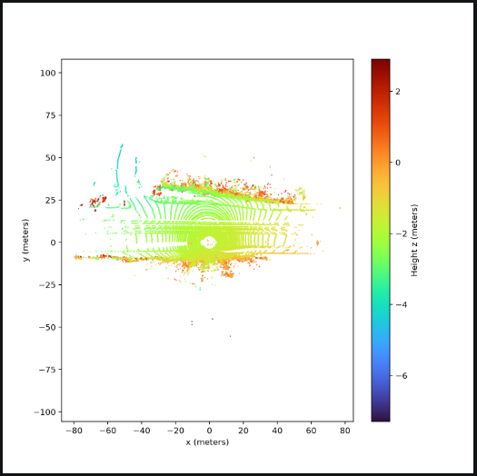
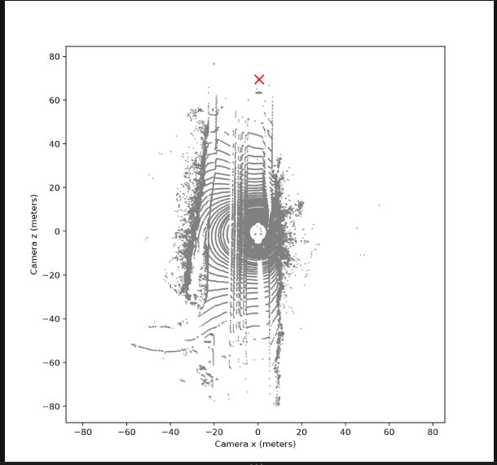
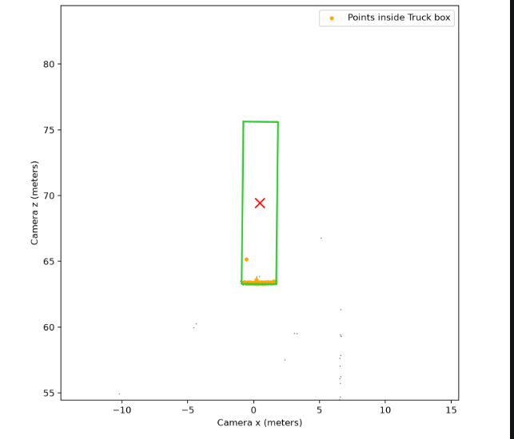
LiDAR to Camera Coordinate transformation

Slide 8
Construction of 3D Bounding Box
Each KITTI label provides the object’s height, width, length, location, and yaw angle.
The location gives the box’s bottom center in camera coordinates.
The code creates four footprint corners using the object’s width and length.
It rotates the corners by the yaw angle and places them at the labelled location.
It creates the top corners using the object’s height. Since camera y points downward, the top is at bottom_y − height.
The code connects the eight corners to form the 3D box

Slide 9
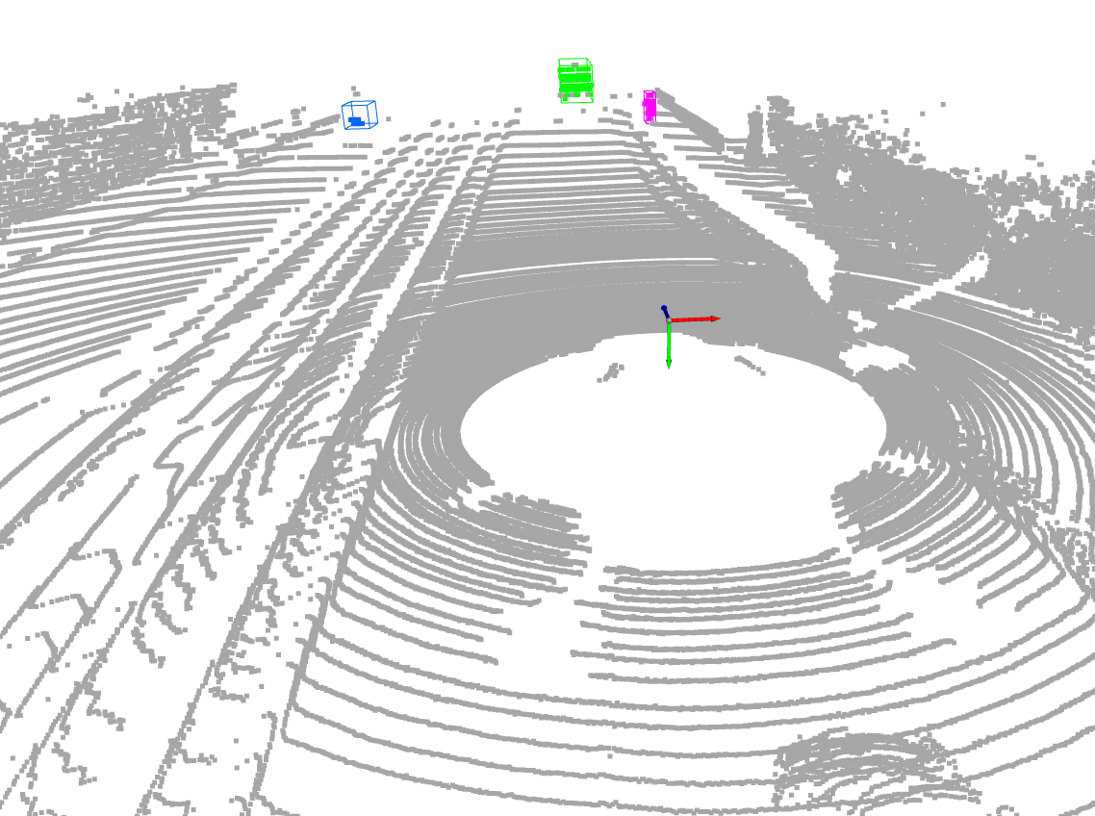
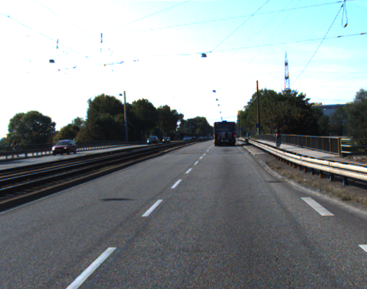
Construction of 3D Bounding Box

Slide 10
Multi Object Visualization
The 3D viewer displays multiple labelled objects in the same LiDAR frame.
Each supported class—Car, Truck, Pedestrian, Cyclist, and Van—has its own box color.
LiDAR points inside each box are highlighted; the rest of the cloud provides scene context.
The viewer lets us rotate and zoom to inspect the boxes from different angles.

Slide 11
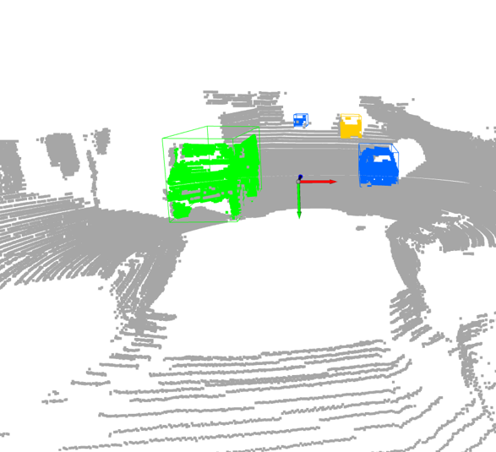
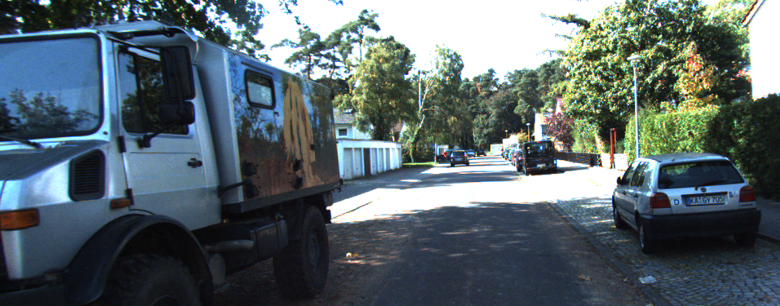
Multi Object Visualization

Slide 12
Learnings and Challenges
Learnings:
How to read KITTI LiDAR scans, labels, and calibration files.
How to transform points between LiDAR and camera coordinates.
How object dimensions, location, and yaw are used to construct 3D boxes.
How to use Open3D to inspect point clouds and labelled objects.
Challenges:
Points and boxes did not line up
Boxes were difficult to orient correctly
Managing of different python extensions.

Slide 13
Conclusion & References
This project used KITTI LiDAR scans and calibration data to transform point clouds into camera coordinates and visualize labelled objects with 3D bounding boxes. Through the project, I learned how coordinate transformations and object dimensions, positions, and orientations are used to construct and display these boxes. As a next step, I would like to use a trained model to detect objects and predict their 3D bounding boxes.
References:
Mousavian, A. et al. “3D Bounding Box Estimation Using Deep Learning and Geometry.” CVPR, 2017.
Geiger, A., Lenz, P. & Urtasun, R. “Are We Ready for Autonomous Driving? The KITTI Vision Benchmark Suite.” CVPR, 2012.
Lang, A. H. et al. “PointPillars: Fast Encoders for Object Detection From Point Clouds.” CVPR, 2019.

